Slide 1



ICT Application (Teaching, Learning, Research, and Team Communication Tools)

Slide 2









ICT in Education
Increased access to Resources
Enhanced Teaching-Learning Process Personalization of Learning Collaborative Learning
Improved Communication Convenience
Importance of ICT in modern education
Impact of COVID-19 on ICT adoption

Slide 3

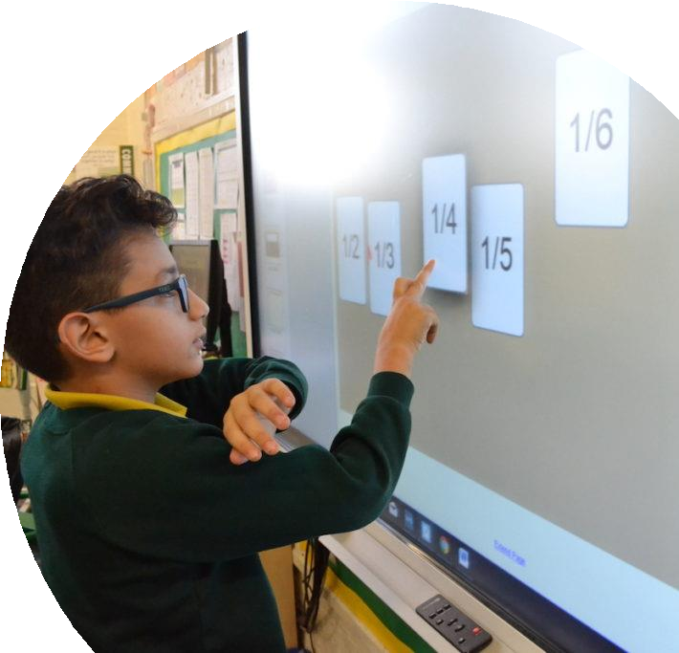
ICT in Teaching
Digital Classrooms: Virtual classrooms, interactive whiteboards, and online assessment tools
Teaching Resources: E-books, online courses, and educational videos

Slide 4





Digital Classrooms
Virtual classroom platforms:
  Zoom
  Teams
  Google Classroom
Tools:
  Interactive whiteboards (SMART)
  Digital projectors
Online assessment tools:
  Google Forms
  Quizizz

Slide 5





Teaching Resources
E-books and MOOCs(Massive Open Online Courses.)
  Khan Academy
  Coursera
Educational videos and platforms
  YouTube
Open Educational Resources (OERs)
  OER Commons (a place where teachers and students can find free educational materials.)
  The MIT OpenCourseWare

Slide 6
E-Learning Platforms
Mobile Learning (m-Learning)
ICT in Learning
Collaborative Learning
Gamification

Slide 7



E-Learning Platforms
Moodle (NUST LMS)
Blackboard
Canvas
Benefits:
  access course materials
  submit assignments
  participate in discussions
  receive grades
Integration with third-party tools and student engagement
  Turnitin for plagiarism checking
  YouTube video embeddings
  Video Conferencing: Zoom, MS Teams integration
  Collaboration: OneDrive, OneNote, Microsoft 365, Google Docs
  File storage: Google drive, Google Workspace

Slide 8



Mobile Learning
Mobile apps allow students to learn anytime, anywhere
  Duolingo (language learning)
  Khan Academy (various subjects)
  SoloLearn (coding)

Slide 9



Collaborative Learning
Tools like Google Docs, OneNote, Padlet
  Virtual study groups
  work together on projects
  share notes
  brainstorm ideas in real-time
  real-time collaboration

Slide 10
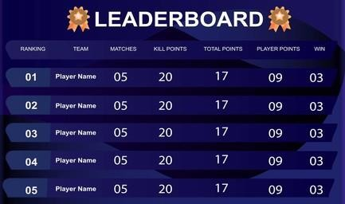
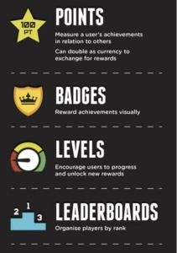

Gamification in Learning
Turn learning into a game
Using points, badges, and leaderboards to motivate students
Can increase engagement
Make challenging topics more accessible
  Kahoot!
  Quizlet
  Classcraft

Slide 11
Research Databases
IEEE Xplore, Google Scholar, JSTOR
ICT in Research
Data Collection and Analysis
Power BI, SPSS
Collaborative Research Tools
Overleaf

Slide 12


Research Databases
Provide access to academic papers, conference proceedings, and journals
Keep researchers updated with the latest developments in their fields
Search techniques (Boolean operators, citation tracking)

Slide 13


Data Collection and Analysis
Allow researchers to design surveys, collect data, and perform statistical analyses
Data Visualization: Tools like Tableau, Power BI, and R allow researchers to create compelling visual representations of their data, making it easier to communicate findings.

Slide 14
Collaborative Research Tools
Collaborative writing with Overleaf
  commonly used in academic publishing for formatting research papers.

Slide 15
Communication Tools: Email clients, instant messaging (Slack, Teams)
Project Management: Jira
Video Conferencing: Zoom, Skype
File Sharing and Collaboration: Google Drive, Dropbox, OneDrive
ICT in Team Communication

Slide 16




Communication Tools
Email clients (Gmail, Outlook)
  Essential for formal communication
  Integrate with calendars and task management systems
Instant messaging for teams (Slack, Microsoft Teams)
  Quick, informal communication within teams
  Channels or groups can be created for different projects
  Can be integrated with other apps like Google Drive and Trello.

Slide 17

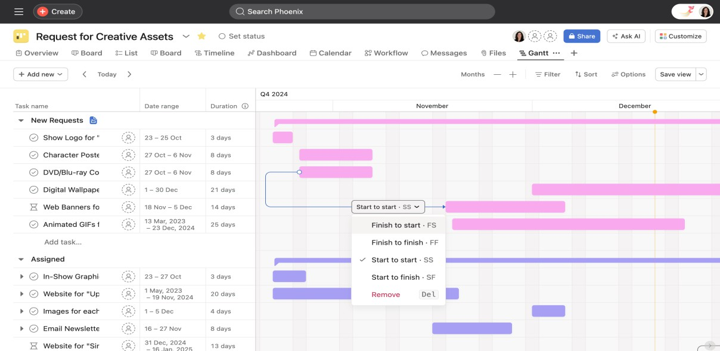
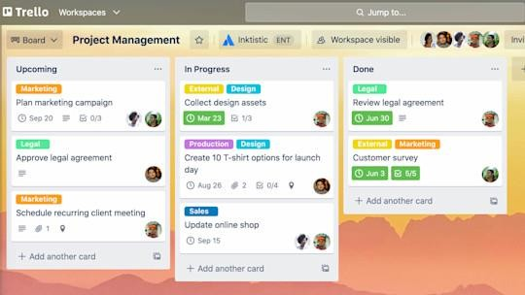
Project Management Tools
Organizing tasks with Trello, Jira
  Using Gantt charts for project timelines
  Help teams organize tasks
  Set deadlines
  Assign responsibilities
  Track progress.
Trello’s card-based system is particularly popular for
visualizing workflows.

Slide 18


Video Conferencing
Platforms like Zoom, Skype, WebEx
  Support virtual meetings webinars, and workshops.
  Features like screen sharing, breakout rooms, and recording make them versatile tools for both education and business environments.
Best practices:
  Maintaining a professional environment
  Managing time effectively
  Using virtual backgrounds when necessary.

Slide 19
File Sharing and Collaboration
Cloud storage solutions (Google Drive, Dropbox, OneDrive)
  Allow team members to share files and collaborate in real-time.
  Features like version control and shared folders are critical for collaborative work.
Document collaboration
  Real-time document editing in Google Docs or Office 365 allows multiple users to work on a document simultaneously, tracking changes and comments.

Slide 20
Access to Technology
Poor internet can make online learning difficult.
We can help by giving cheap devices and internet.
Data Privacy & Security
Keep student information safe.
Use strong passwords.
Follow safety rules like GDPR(General Data Protection Law)
Ethical Considerations
Use AI properly.
Do not cheat or copy.
Turnitin helps find copied work.
Challenges and Considerations

Slide 21
Successful ICT Integration:
Example 1: Khan Academy: Khan Academy uses ICT to provide free, world-class education to anyone, anywhere. Their platform offers video lessons, practice exercises, and a personalized learning dashboard.
Example 2: Google Classroom Schools: Schools have adopted Google Classroom to maintain continuity of education during the COVID-19 pandemic, enabling teachers to manage classes and assignments online.
Case Studies

Slide 22
Assignment # 1: Applications of ICT
Explain the importance and applications of Information and Communication Technology (ICT) in modern society. Discuss how ICT is used in the following areas:
                Education
                Health
                Entertainment
                Businesses
                Industries
Also explain how ICT improves communication, access to information, efficiency, and services in each of these areas.
DEADLINE: 16TH OCT 2026
23

